Slide 1

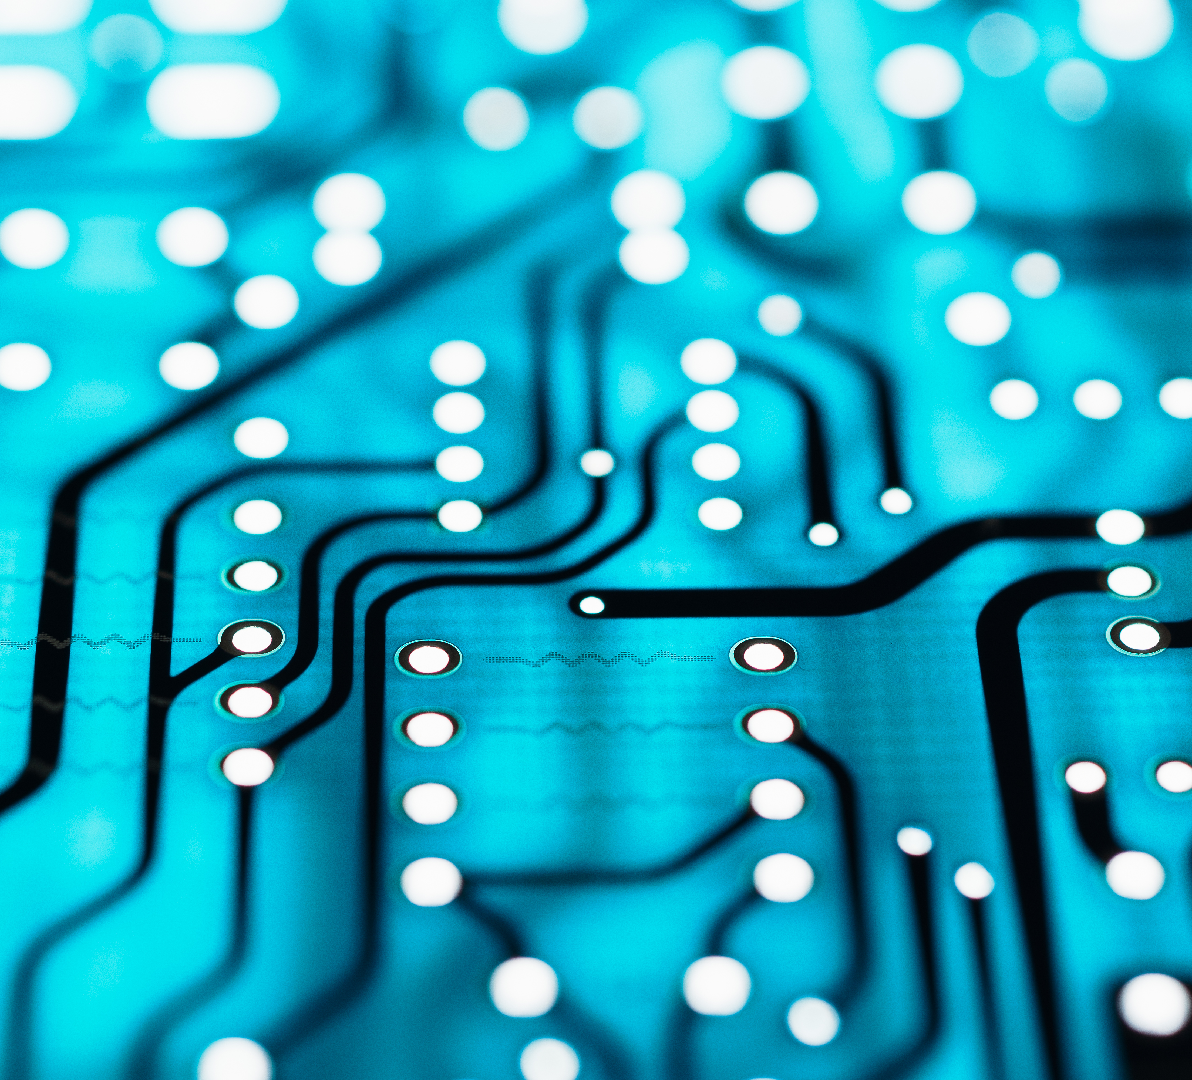
BJT & Transducers
Some questions relating to bipolar junction transistors and transducers in some past examination papers are modified to be revision questions here.
Unit 21 BJT
Unit 22 Transducers

Slide 2
2018/19 S1
Modified Examination Questions

Slide 3

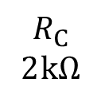
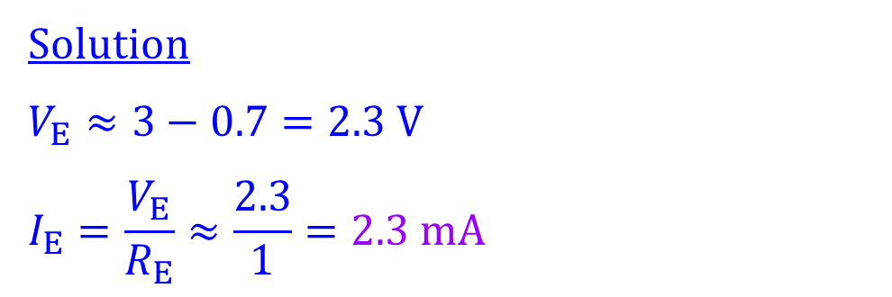
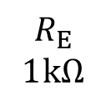
18/19 S1 A8 (modified)
Explanation
Calculate the emitter current of the silicon transistor.
$$R_{C}$$
2 kΩ
Solution
$$V_{E}≈3−0.7=2.3 V$$
$$I_{E}=\frac{V_{E}}{R_{E}}≈\frac{2.3}{1}=2.3 mA$$
9 V
3 V
$$R_{E}$$
1 kΩ

Slide 4
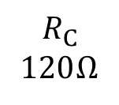
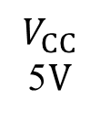
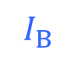
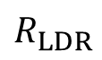
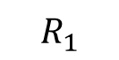
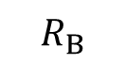
18/19 S1 B1 (modified)
Explanation
Name the circuit and explain how it works.
Solution
This is an automatic lighting circuit.
$$R_{C}$$
120 Ω
$$R_{1}$$
When the intensity of the ambient light shining on the light dependent resistor (LDR) increases, the resistance of the LDR decreases. This causes the voltage across the LDR and the base current to decrease. A drop in the base current will result in a drop in the collector current and a decrease in the intensity of the LED light.
$$I_{B}$$
$$V_{CC}$$
5 V
$$R_{B}$$
$$R_{LDR}$$
On the other hand, a decrease in the intensity of the ambient light will increase the resistance of the LDR and results in brighter LED light.

Slide 5
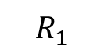
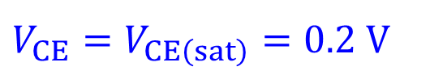
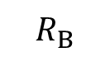
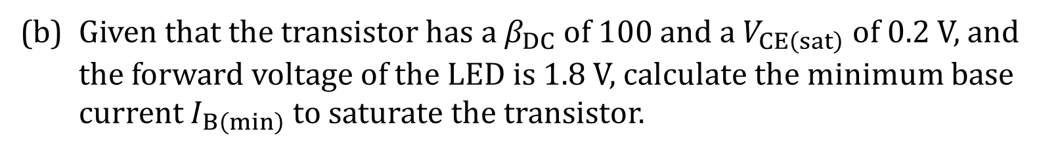
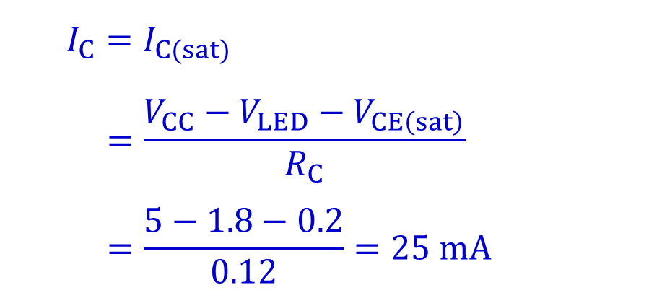
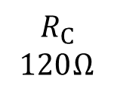
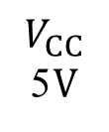

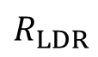
18/19 S1 B1 (modified)
(b) Given that the transistor has a $β_{DC}$ of 100 and a $V_{CE\left(sat\right)}$ of 0.2 V, and the forward voltage of the LED is 1.8 V, calculate the minimum base current $I_{B\left(min\right)}$ to saturate the transistor.
Solution
When the transistor is saturated,
$$R_{C}$$
120 Ω
$$R_{1}$$
$$V_{CE}=V_{CE\left(sat\right)}=0.2 V$$
$$I_{B}$$
$$I_{C}=I_{C(sat)}$$
$$=\frac{V_{CC}−V_{LED}−V_{CE\left(sat\right)}}{R_{C}}$$
$$=\frac{5−1.8−0.2}{0.12}=25 mA$$
$$V_{CC}$$
5 V
$$R_{B}$$
$$R_{LDR}$$

Slide 6
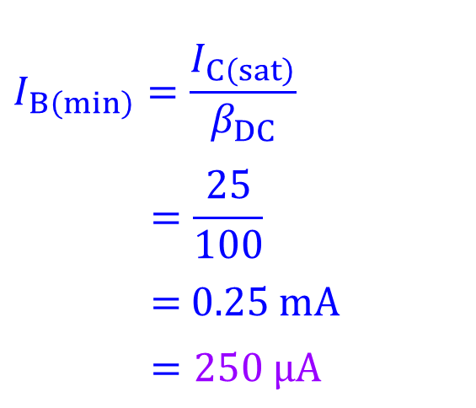
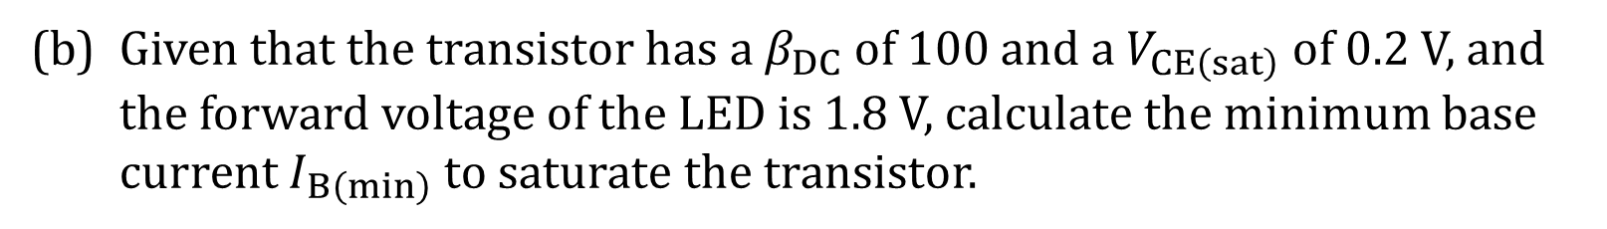
18/19 S1 B1 (modified)
(b) Given that the transistor has a $β_{DC}$ of 100 and a $V_{CE\left(sat\right)}$ of 0.2 V, and the forward voltage of the LED is 1.8 V, calculate the minimum base current $I_{B\left(min\right)}$ to saturate the transistor.
Solution
$$R_{C}$$
120 Ω
$$I_{B\left(min\right)}=\frac{I_{C\left(sat\right)}}{β_{DC}}$$
$$=\frac{25}{100}$$
= 0.25 mA
$$=250 μA$$
$$R_{1}$$
$$I_{B}$$
$$V_{CC}$$
5 V
$$R_{B}$$
$$R_{LDR}$$

Slide 7
2017/18 S2
Modified Examination Questions

Slide 8
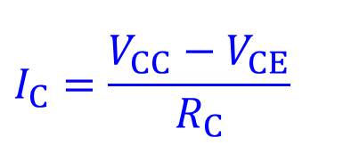
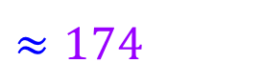
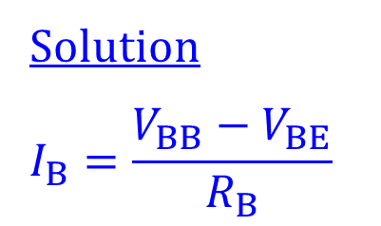
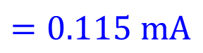
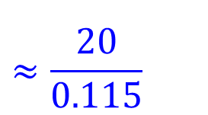
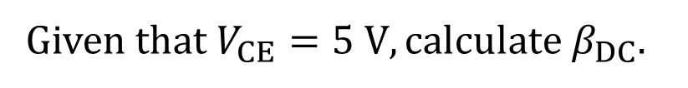
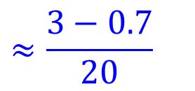
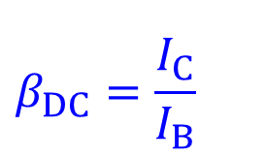
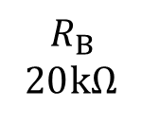
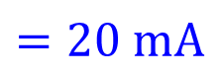
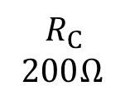
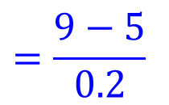
17/18 S2 A8 (modified)
Explanation
Given that $V_{CE}=5 V, calculate β_{DC}$.
Solution
$$I_{B}=\frac{V_{BB}−V_{BE}}{R_{B}}$$
$$R_{C}$$
200 Ω
$$β_{DC}=\frac{I_{C}}{I_{B}}$$
$$R_{B}$$
20 kΩ
9 V
$$≈\frac{20}{0.115}$$
$$≈\frac{3−0.7}{20}$$
3 V
$$=0.115 mA$$
$$≈174$$
$$I_{C}=\frac{V_{CC}−V_{CE}}{R_{C}}$$
$$=\frac{9−5}{0.2}$$
$$=20 mA$$

Slide 9

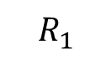
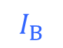
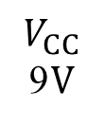
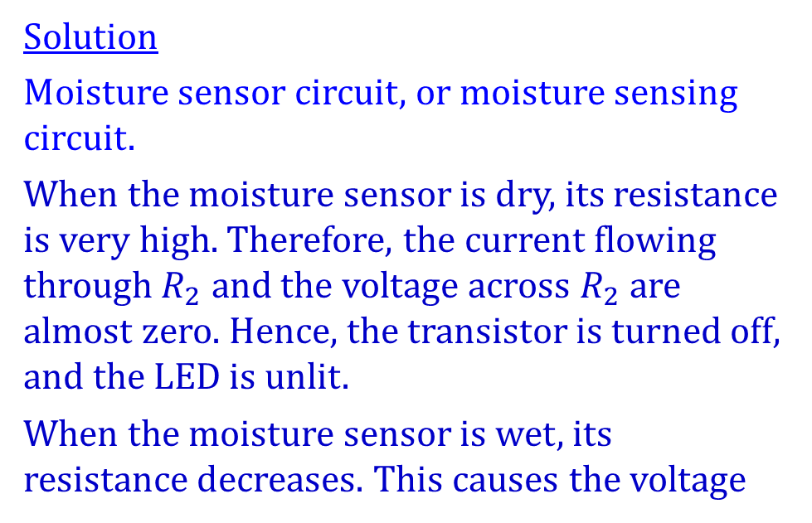
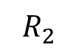
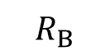
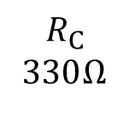
17/18 S2 B1 (modified)
Explanation
Name the circuit and explain how it works.
$$R_{C}$$
330 Ω
Solution
Moisture sensor circuit, or moisture sensing circuit.
When the moisture sensor is dry, its resistance is very high. Therefore, the current flowing through $R_{2}$ and the voltage across $R_{2}$ are almost zero. Hence, the transistor is turned off, and the LED is unlit.
When the moisture sensor is wet, its resistance decreases. This causes the voltage
$$R_{1}$$
$$I_{B}$$
$$V_{CC}$$
9 V
$$R_{B}$$
$$R_{2}$$
across $R_{2}$ to increase. When the sensor is wet enough, the transistor will be biased in the active region or even in the saturation region. Hence the LED is lit.

Slide 10
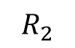
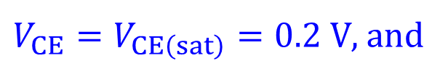
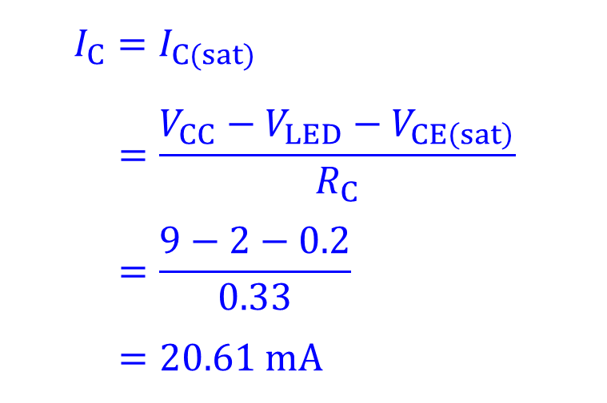
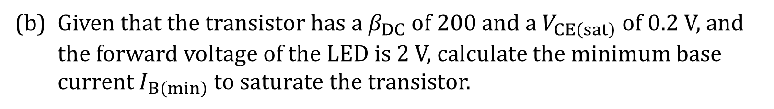
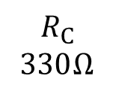
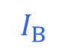
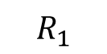
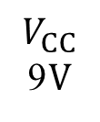
17/18 S2 B1 (modified)
Explanation
(b) Given that the transistor has a $β_{DC}$ of 200 and a $V_{CE\left(sat\right)}$ of 0.2 V, and the forward voltage of the LED is 2 V, calculate the minimum base current $I_{B\left(min\right)}$ to saturate the transistor.
Solution
When the transistor is saturated,
$$R_{C}$$
330 Ω
$$R_{1}$$
$V_{CE}=V_{CE\left(sat\right)}=0.2 V$, and
$$I_{B}$$
$$I_{C}=I_{C(sat)}$$
$$=\frac{V_{CC}−V_{LED}−V_{CE\left(sat\right)}}{R_{C}}$$
$$=\frac{9−2−0.2}{0.33}$$
$$=20.61 mA$$
$$V_{CC}$$
9 V
$$R_{B}$$
$$R_{2}$$

Slide 11
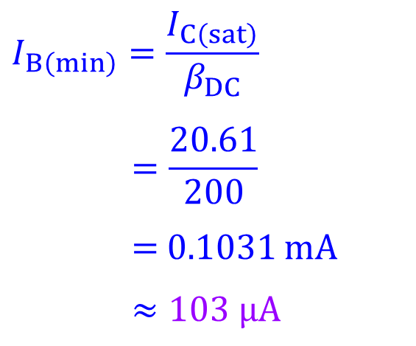
17/18 S2 B1 (modified)
Explanation
(b) Given that the transistor has a $β_{DC}$ of 200 and a $V_{CE\left(sat\right)}$ of 0.2 V, and the forward voltage of the LED is 2 V, calculate the minimum base current $I_{B\left(min\right)}$ to saturate the transistor.
Solution
$$R_{C}$$
330 Ω
$$R_{1}$$
$$I_{B\left(min\right)}=\frac{I_{C\left(sat\right)}}{β_{DC}}$$
$$=\frac{20.61}{200}$$
= 0.1031 mA
$$≈103 μA$$
$$I_{B}$$
$$V_{CC}$$
9 V
$$R_{B}$$
$$R_{2}$$

Slide 12
2017/18 S1
Modified Examination Questions

Slide 13
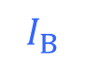
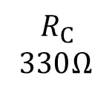





17/18 S1 A7 (modified)
Explanation
Calculate the base current of the silicon transistor.
$$R_{C}$$
330 Ω
Solution
$$I_{B}=\frac{V_{BB}−V_{BE}}{R_{B}}$$
$$I_{B}$$
9 V
$$R_{B}$$
43 kΩ
$$≈\frac{5−0.7}{43}$$
5 V
$$=0.1 mA$$
$$=100 μA$$

Slide 14







17/18 S1 B1 (modified)
Explanation
The resistance of the light dependent resistor $R_{LDR}$ ranges from 500 Ω to 1 MΩ.
$$R_{C}$$
300 Ω
$$R_{1}$$
24 kΩ
(a) State the condition causing $R_{LDR}=1 MΩ$.
$$R_{B}$$
4.3 kΩ
Solution
$R_{LDR}=1 MΩ$ when the LDR is in a dark enough environment.
$$V_{CC}$$
9 V
$$R_{LDR}$$

Slide 15













17/18 S1 B1 (modified)
The DC current gain of the transistor, $β_{DC}=110.$
The forward voltage of the LED, $V_{LED} =2.1 V$.
$$R_{C}$$
300 Ω
$$R_{1}$$
24 kΩ
(b) When $R_{LDR}=5 kΩ$, the voltage across the LDR is $1. 2 V$ and the transistor is biased in the active region. Calculate $I_{B}$, $I_{C}$ and $V_{CE}$ when $R_{LDR}=5 kΩ$.
$$R_{B}$$
4.3 kΩ
$$V_{CC}$$
9 V
$$R_{LDR}$$
Solution
$$I_{B}=\frac{V_{LDR}−V_{BE}}{R_{B}}$$
(b)
$$I_{C}=I_{B}×β_{DC}$$
$$≈0.1163×110$$
$$V_{CE}=V_{CC}−I_{C} R_{C}−V_{LED}$$
$$≈\frac{1.2−0.7}{4.3}$$
$$≈12.79$$
$$≈9−12.79×0.3−2.1$$
$$≈0.1163 mA$$
$$≈12.8 mA$$
$$≈3.06 V$$
$$≈116 μA$$

